Slide 1
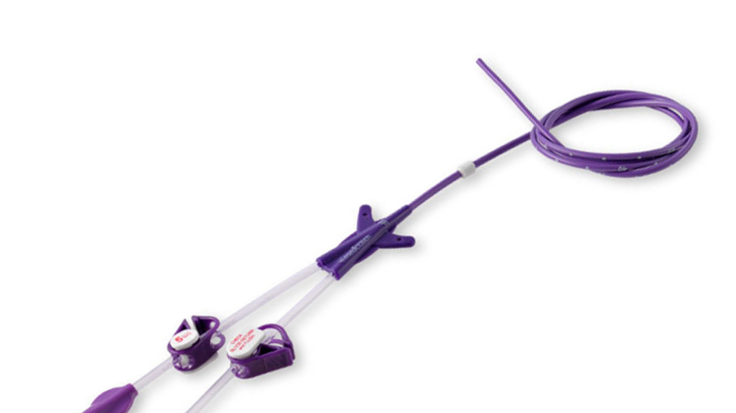
Preventing Central Line Associated Blood Stream Infections (CLABSI)
Latara McGuire BSN, CMSRN
School of Nursing, University of North Carolina at Greensboro
NUR 614-20: Information Technology in Nursing Administration
Fall 2024
This Photo by Unknown Author is licensed under CC BY-NC-ND

Slide 2
The problem
$17,896 to $94,8479
28,000 patients die in ICU each year
0.150 excess mortality
Increases morbidity, mortality, and costs (Agency for Healthcare Research and Quality, n.d)

Slide 3
Literature Review
Having a CLABSI prevention nurse reduced rates and improved bundle compliance (Star et al., 2024)
How nurses think about CLABSI bundles affects how they adhere to it (Connor et al., 2023). Competing priorities are barriers to adherence (Connor et al., 2023)
A CLABSI rounding team of infection preventionists, clinical nurse specialists, and clinical nurse leaders promotes awareness of CLABSI prevention and safety (Pate et al., 2022).

Slide 4
How to capture CLABSI data from a unit level perspective
Surveillance on every patient with documentation of a central line
Suspected infection based on clinical presentation and lab values
Laboratory confirmation

Slide 5
How to capture CLABSI data from a unit level perspective
Infection prevention
Surveillance
Suspected Infection based on clinical presentation and lab values
Laboratory confirmation

Slide 6
How to capture CLABSI data from a unit level perspective
Unit manager notified
Occurrence or prevalence counted
Unit staff notified

Slide 7
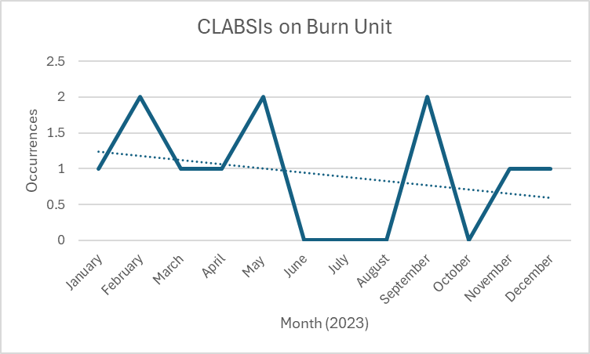
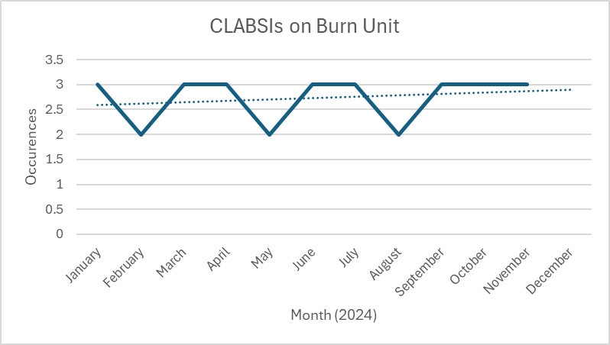
The Problem

Slide 8
Strategies and implications for Nursing leadership
CLABSI Prevention
Multidisciplinary approach to root cause analysis (RCA)
Routine audits of CLABSI bundle metrics
Leadership rounding can identify barriers and opportunities, promote engagement, accountability, and education (Owings et al., 2018).
Nursing leadership can empower unit manager and unit nurses to review the literature and implement evidence-based interventions to promote adherence

Slide 9
Reference
1.Agency for Healthcare Research and Quality. (n.d). Central line-associated bloodstream infections (CLABSI). Retrieved from https://www.ahrq.gov/topics/central-line-associated-bloodstream-infections-clabsi.html
2.Agency for Healthcare Research and Quality. (2017). Estimating the additional hospital inpatient cost and mortality associated with selected hospital acquired conditions. Retrieved from https://www.ahrq.gov/hai/pfp/haccost2017-results.html
3. Connor, L., Zadvinskis, I. M., Roberts, H., & Melnyk, B. M. (2023). Nurses’ perceptions of adherence to the central line maintenance bundle: Linkages to thoughts, emotions,and behavior. Western Journal of Nursing Research, 45(7), 599–606. https://doi-org.proxy180.nclive.org/10.1177/01939459231162904
4. National Healthcare Safety Network. (2024). Bloodstream infection event (central line-
associated bloodstream infection and non-central line associated bloodstream
infection). CDC. Retrieved from
https://www.cdc.gov/nhsn/pdfs/pscmanual/4psc_clabscurrent.pdf
5. Owings, A., Graves, J., Johnson, S., & Gipson, M. (2018). Leadership line care rounds:
Application of the engage, educate, execute, and evaluate improvement model for the
prevention of central line-associated bloodstream infections in children with cancer.
American Journal of Infection Control 46(2), 229-231.
https://doi.org/10.1016/j.ajic.2017.08.032
6. Pate, K. , Brelewski, K. , Rutledge, S. , Rankin, V. & Layell, J. (2022). CLABSI rounding
team:A collaborative approach to prevention. Journal of Nursing Care
Quality, 37 (3), 275-281. doi: 10.1097/NCQ.0000000000000625.
7. Star, K.E., Lindsey, K., Reese, S.M., Paulino, L., Hernandez, L.L, Tynes, I., Eiseman,
K., & Tynes, J. (2024). Reducing central line-associated bloodstream infection with a
dedicated CLASBI prevention registered nurse role. American Journal of Infection
Control, 52(6),659-663. https://doi.org/10.1016/j.ajic.2023.11.021

